Slide 1


ORIENTATION TO SKILLBUILDING AND map+
By Arlene Zimmerly, Coauthor
Gregg College Keyboarding & Document Processing, 11e
3/27/11
Note: This presentation was created for use by instructors or students to serve as a possible model in a keyboarding course. Specific course requirements may vary.

Slide 2
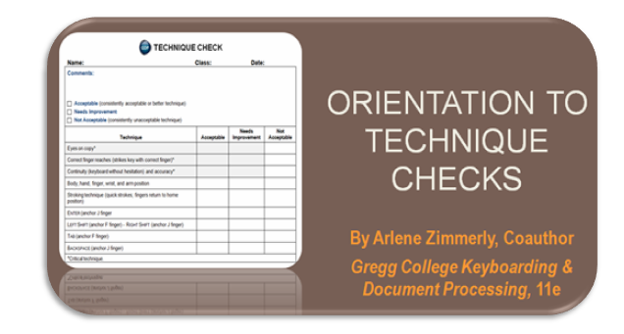
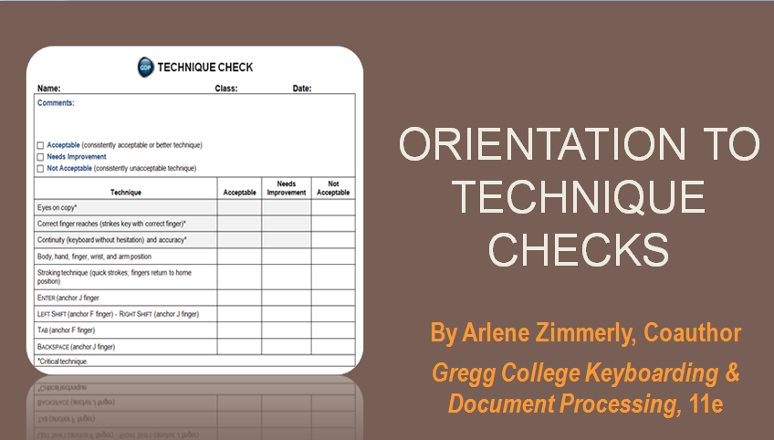
Typing Technique
2
Proper typing technique and technique checks were discussed in “Orientation to Technique Checks.” If you have not yet viewed that presentation, please do that first.

Slide 3
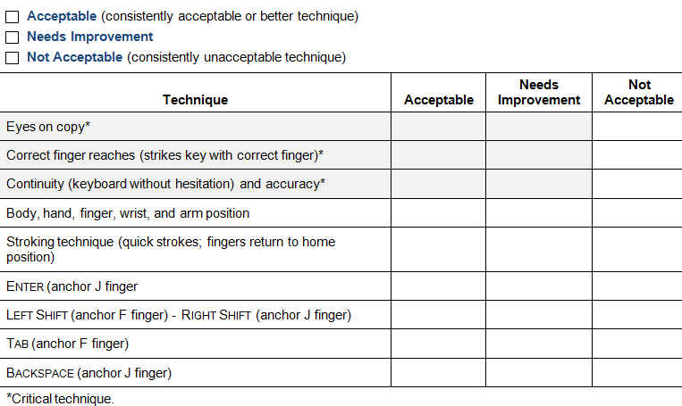
Assessment Is First . . .
3
*Shaded items indicate critical techniques that must be acceptable.

Slide 4
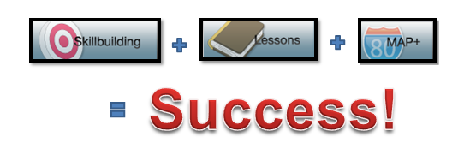



Followed by Remediation
4
Success!
GDP’s Skillbuilding, Lessons, and MAP+ features are truly a powerful, effective, convenient “triple-threat remediation” plan.
Each routine will be discussed in detail as it relates to remediating specific keyboarding problems identified in the technique check.

Slide 5
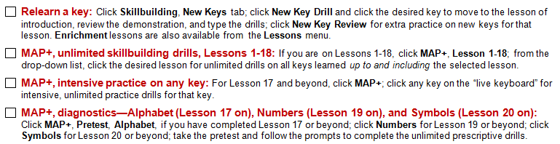
Skillbuilding + Lessons + MAP+
5
Use the Skillbuilding button, New Key Drill and New Key Review, to relearn keys and practice new keys.
Use the Lessons button, Lesson “X” Enrichment, for extra practice on Lessons 1-20.
Use the MAP+ button for unlimited skillbuilding drills beginning with Lesson 1 and for intensive practice and diagnostics for Lesson 17 on.

Slide 6
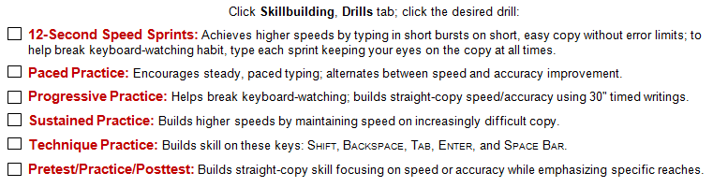
Skillbuilding Drills Tab
6
Use the Skillbuilding button, Drills tab, to go directly to the skillbuilding routines listed below.

Slide 7
Correct Fingering First
7
The first item to address is correct fingering.
Before you move on to remediating the more refined aspects of keyboarding technique, you must first be sure you are using the correct fingering.
The most effective way to relearn a keystroke is to move to the lesson in which it was introduced and practice it until you have relearned the keystroke.

Slide 8
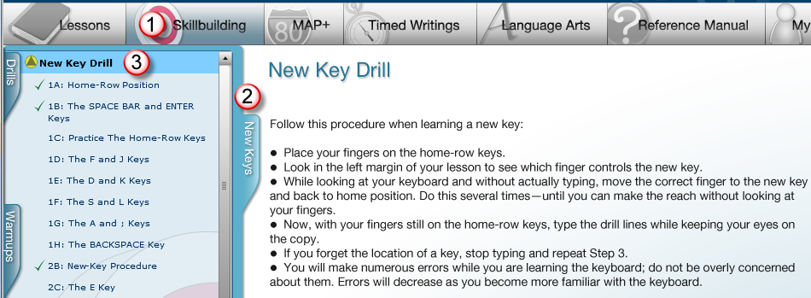
Skillbuilding – New Key Drills
8
Click Skillbuilding, New Keys tab, New Key Drill menu.
Click the desired key on the menu to move directly to the lesson where the key was introduced.

Slide 9
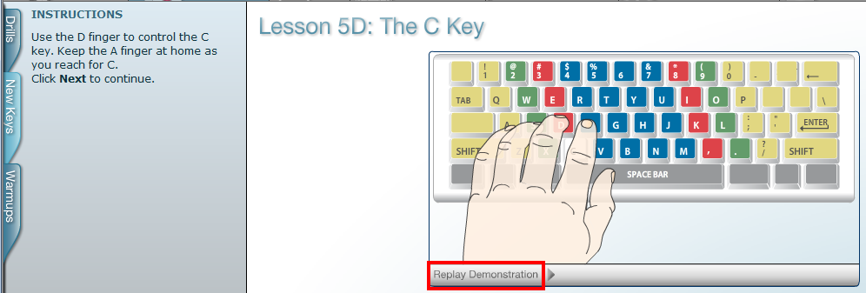
Relearn Key — Demonstration
9
In this example, when you click 5D: The C Key, you are moved directly to Lesson 5D where this key was introduced.
Click the Replay Demonstration button; if possible, listen to the directions; and study the correct fingering until you relearn the keystroke; then click Next.

Slide 10
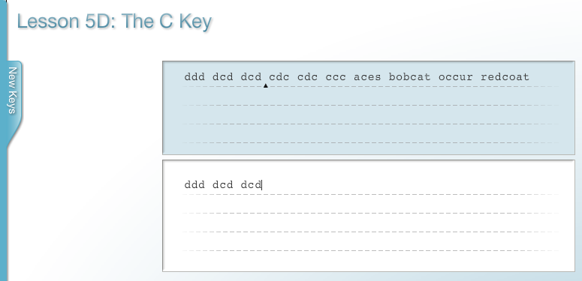
Practice Drill Lines
10
Type the drill lines on each screen using correct fingering and technique until you feel confident that you have relearned the key.

Slide 11
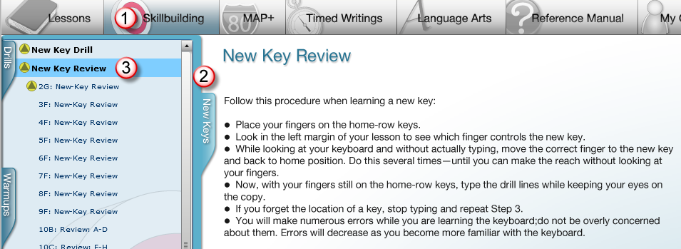
Skillbuilding – New Key Drills
11
Click Skillbuilding, New Keys tab, New Key Review menu.
Click the desired key on the menu to move directly to the New Key Review for drill lines that focus on all the new keys presented in that lesson.

Slide 12
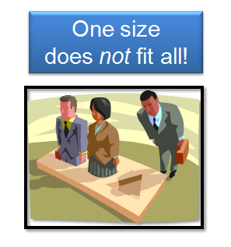
MAP+ — Individualized Diagnostics
12
MAP+ is a highly sophisticated, individualized error-analysis and remediation program and has no counterpart anywhere else in keyboard publishing!
MAP+ may be used for unlimited skillbuilding beginning with Lesson 1 and for individualized diagnostics and remediation for alphabet, number, and symbols keys beginning in Lesson 17, 19, and 20 respectively.
One size
does not fit all!
MAP+ identifies and remediates 80 different types of misstrokes.

Slide 13
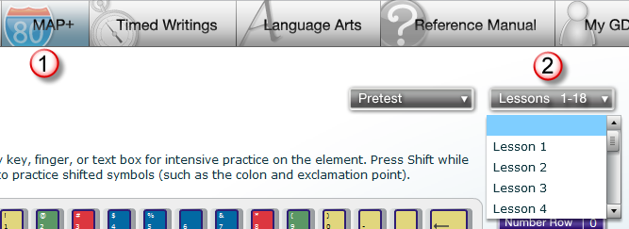
MAP+ — Additional Skillbuilding
13
If you are on Lessons 1-18, click MAP+, Lesson 1-18; from the drop-down list, click the desired lesson for unlimited additional practice drills on all keys learned up to and including the selected lesson.

Slide 14
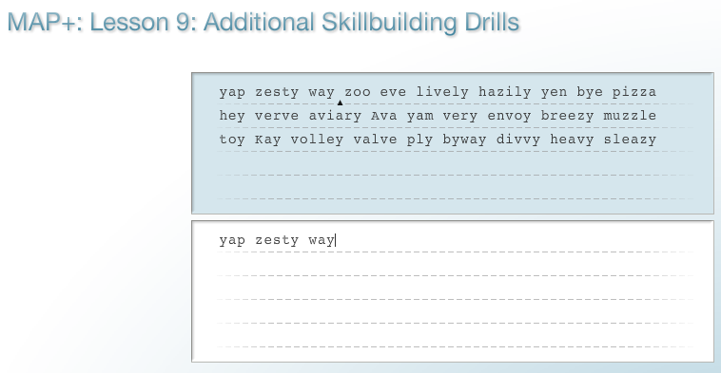
MAP+ — Unlimited Skillbuilding
14
Below is an example of additional, unlimited skillbuilding drills for all keys learned through Lesson 9.

Slide 15
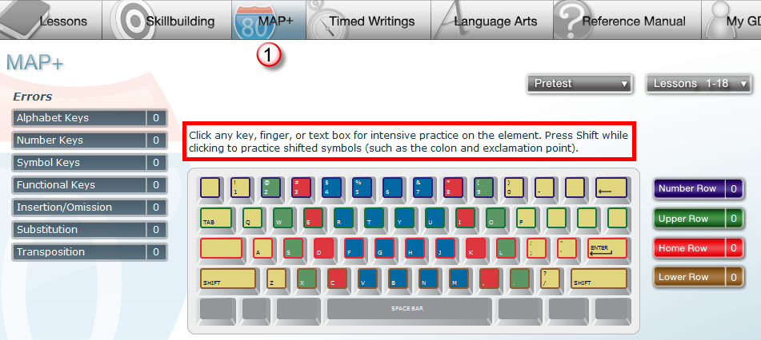
MAP+ — Intensive Practice
15
After you have completed Lesson 17 or beyond, click MAP+.
Click any key on the “live keyboard” for intensive, unlimited practice drills for that key.

Slide 16
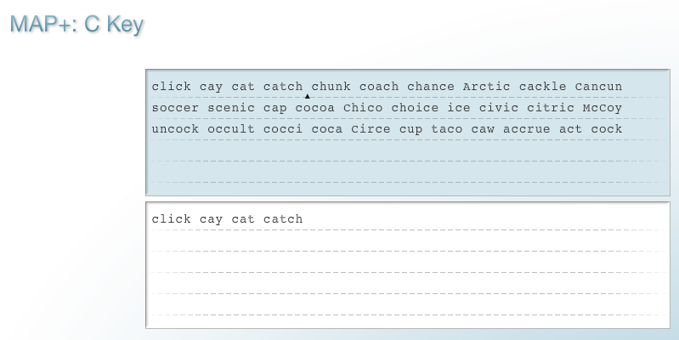
MAP+ — Intensive Practice (cont’d)
16
Below is an example of a MAP+ intensive practice drill for the C key.

Slide 17
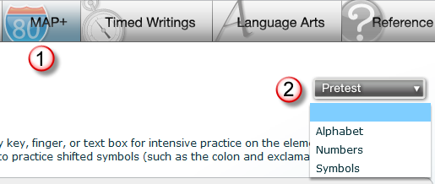
MAP + Diagnostics: Alphabet, Number, and Symbols
17
After you have completed Lesson 17 (for Alphabet diagnostics), Lesson 19 (for Numbers diagnostics), or Lesson 20 (for Symbols diagnostics), click MAP+, Pretest.
From the drop-down list, click the desired drill, take the pretest, and follow the prompts to complete the unlimited prescriptive drills.

Slide 18
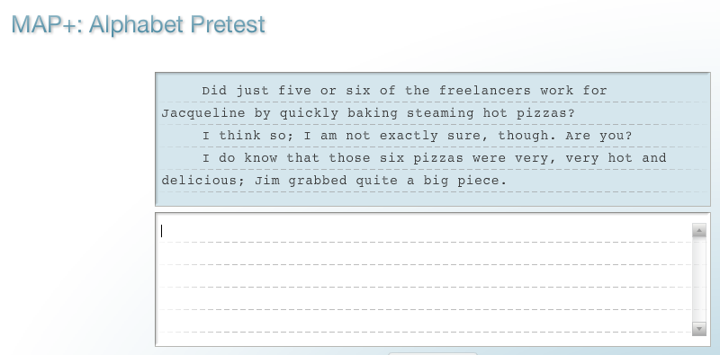
MAP+ — Alphabet Pretest
18
Below is an example of an Alphabet Pretest:

Slide 19
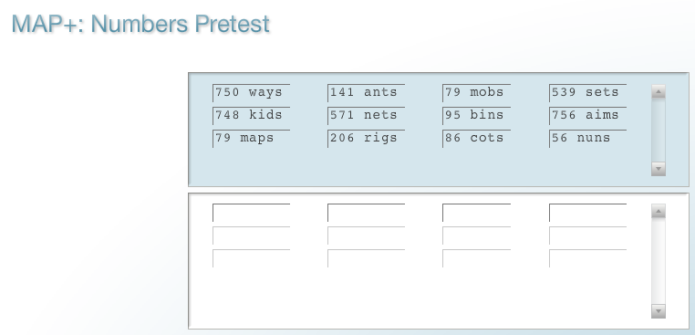
MAP+ — Numbers Pretest
19
Below is an example of a Numbers Pretest.

Slide 20
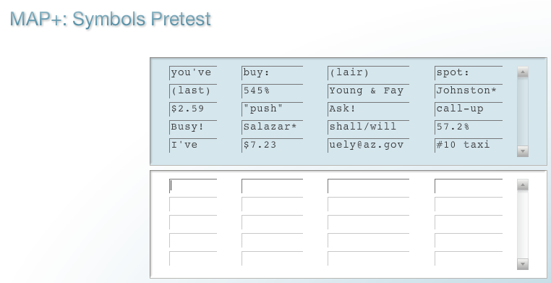
MAP+ — Symbols Pretest
20
Below is an example of a Symbols Pretest.

Slide 21
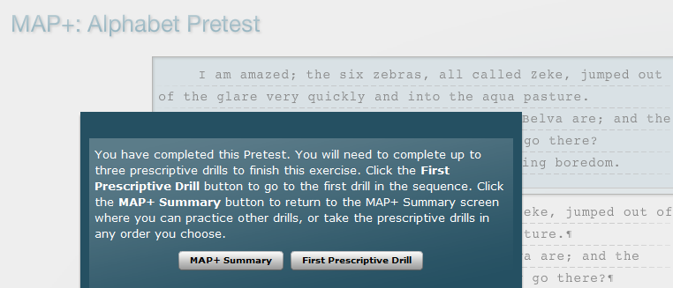
MAP+ — Prescriptive Drills
21
After you take the desired pretest (Alphabet, Numbers, or Symbols), MAP+ will analyze your errors and direct you to the first Prescriptive Drill.
Or you can return to the MAP+ Summary screen to complete the individualized, prescriptive drills in any order desired.

Slide 22
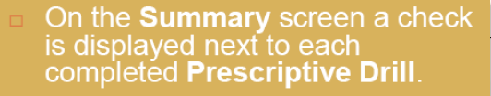
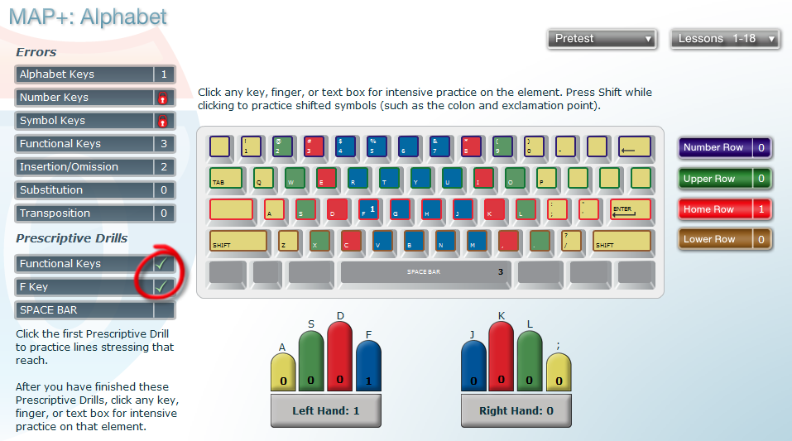
MAP+ — Summary
22
12/18/2010

Slide 23
Skillbuilding Button
23
The Skillbuilding button provides you with convenient access to these drills you can use for remediation:
  12-Second Speed Sprints
  Paced Practice
  Progressive Practice
  Sustained Practice
  Technique Practice
  Pretest/Practice/Posttest

Slide 24
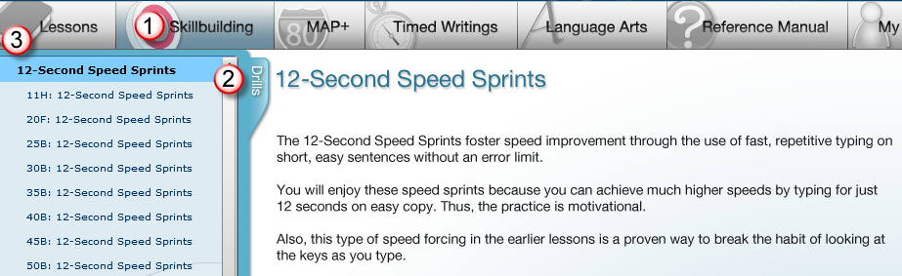
12-Second Speed Sprints Routine
24
Achieves higher speeds by typing in short bursts on short, easy copy without error limits; to help break keyboard-watching habits, type each sprint while keeping your eyes on the copy at all times.

Slide 25
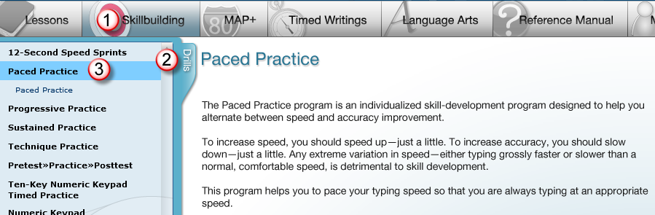
Paced Practice Routine
25
Encourages steady, paced typing; alternates between speed and accuracy improvement; forces you to speed up “just a little” for speed gain and to slow down “just a little” for accuracy gain—any gross deviation from normal speed is detrimental to skill development.

Slide 26
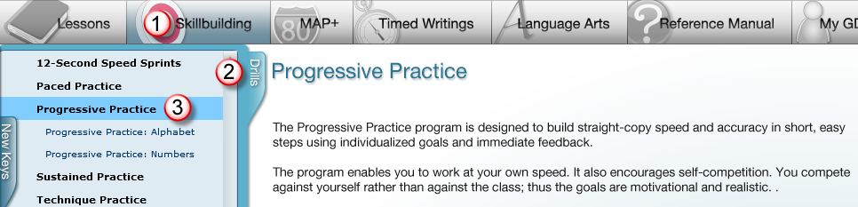
Progressive Practice Routine
26
Helps break keyboard-watching habit; builds straight-copy speed/accuracy using 30" timed writings.

Slide 27
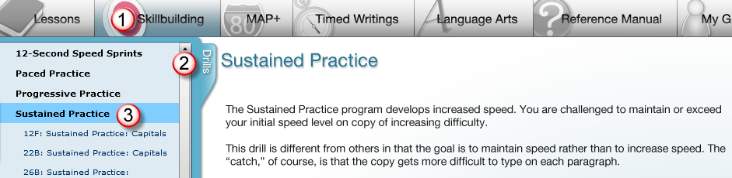
Sustained Practice Routine
27
Builds higher speeds by maintaining speed on increasingly difficult copy.

Slide 28
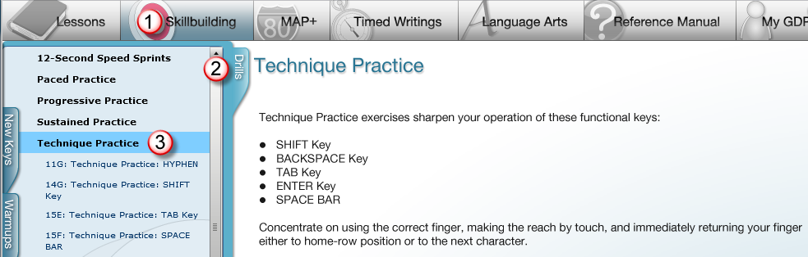
Technique Practice Routine
28
Builds skill on these keys: Shift, Backspace, Tab, Enter, and Space Bar.

Slide 29
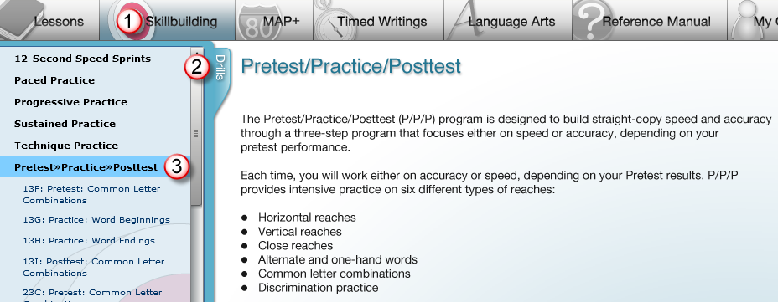
Pretest/Practice/Posttest Routine
29
Builds straight-copy skill focusing on speed or accuracy while emphasizing specific reaches.

Slide 30
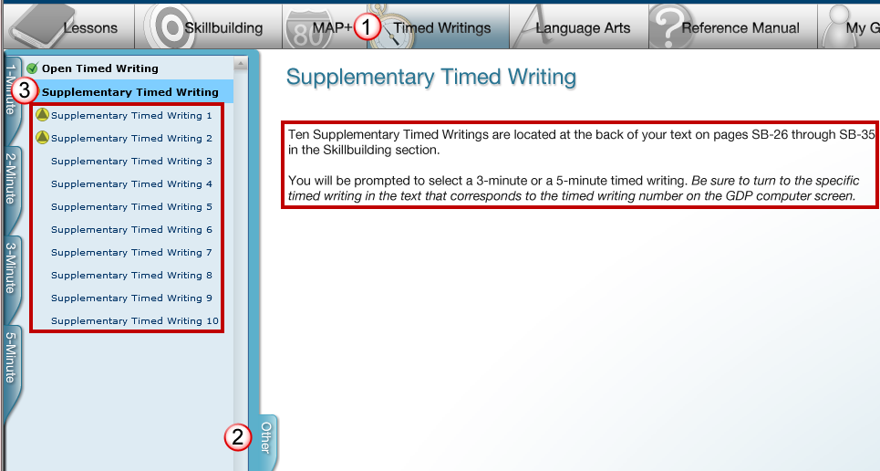
Supplementary Timed Writings
29
Ten back-of-book supplementary timed writings provide more opportunities to measure students’ speed and accuracy.

Slide 31

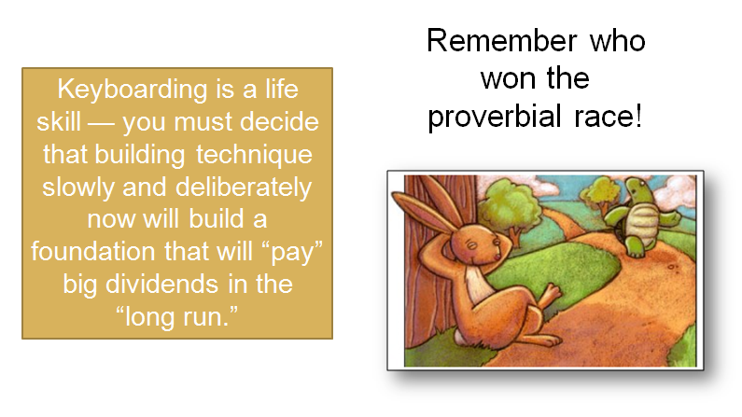

Technique for Sale!
30
Remember who won the proverbial race!
Keyboarding is a life skill — you must decide that building technique slowly and deliberately now will build a foundation that will “pay” big dividends in the “long run.”

Slide 32

Feedback?
31
If you have any questions or comments regarding this presentation, please send an e-mail:
Happy skillbuilding!
Note: This presentation was created for use by instructors or students to serve as a possible model in a keyboarding course. Your specific course requirements may vary.

