Slide 1


Orientation to Keyboarding 2 Online and GDP, 11e
By Arlene Zimmerly, Coauthor*
Gregg College Keyboarding & Document Processing, 11e
* This presentation was created to serve as one example of an orientation to an online keyboarding course. Your specific course requirements may vary.
1

Slide 2


Student Comments
See the FAQs page for other student comments that should inspire and motivate you! This comment is from a Keyboarding 1 student:
“This was one of the most practical courses that I have ever taken. It builds confidence, speed, and eye/hand coordination. I am amazed at my speed. Before I could type only 15 wpm. Now I can type almost 40 wpm. This course has taken me from writing a report from days to just hours. It was really nice to have a teacher who was always ready to answer my questions at any time. Thank you.”
2

Slide 3
Orientation Topics
Factors for Success
Technical Skills Tutorial
Course Description
System Requirements (PC and Mac)
Software Requirements & Supplies
Getting Started
Assignments & Due Dates
Daily Routine & Instructor Annotations
Typing Technique & Technique Check
Assessment
Orientation
3

Slide 4
Factors for Success
Do you have adequate technical skills?
Is your learning style compatible with an online course?
Are you a self-starter determined to read and follow directions?
Are you disciplined enough to stay on schedule and communicate via e-mail on a regular basis?
Do you have a reliable computer and Internet connection?
4

Slide 5
Technical Skills Tutorial
Go to the Technical Skills Tutorial page to review the required skills for this online course.
You need basic computer skills to:
  Navigate Windows.
  Download files.
  Use the GDP Web site.
  Use e-mail.
  Manage files in Windows including finding, opening, printing, and deleting files.
  Troubleshoot basic computer issues.
5

Slide 6
Course Description
If you need to learn to type by touch (without looking), if you need to relearn the keyboard, or if you type less than 30 wpm, you should enroll in Computer Keyboarding 1.
You will learn to type by touch and should develop speeds ranging from 47-50 wpm or higher.
You will build keyboarding speed and accuracy and produce mailable advanced letters, tables, reports, memos, and desktop published documents using Microsoft Word for Windows (2007 or 2010).
6

Slide 7
Minimum System Requirements
Operating System: Windows XP, Windows Vista, Windows 7, or Mac OSX. (See the next page for details on using a Mac.)
Screen Resolution: 1024 x 768 or higher.
High-speed Internet connection.
Internet Explorer 7 or 8 or Firefox 3.5 browser.
Adobe Flash Player 10.
7

Slide 8
GDP on a Mac
GDP is entirely Web-based. You can complete all skillbuilding using the GDP Web site and your textbook.
To complete document processing jobs in Lessons 21 to 120, consider using Boot Camp to create a Windows bootable partition on the Mac hard drive where the Windows version of Word 2007 or 2010 could be installed. Visit http://www.apple.com/support/bootcamp/ for details.
Alternatively, if you have access to a PC with Word 2007 or 2010 for Windows installed, you could use a Mac to complete skillbuilding and a PC to complete document processing activities.
8

Slide 9
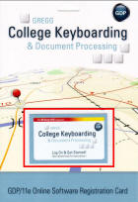
Software Requirements
To log on to GDP online, you must have an
Online Software Student Registration Card,
which is bundled with the textbook or may
be purchased separately at the GDP log-in
screen.
For document processing jobs, you must have
Word 2007 or 2010 for Windows. Click here for details.
Internet Explorer 7+ or 8 or Firefox 3.5 browser.
Adobe Flash Player 10 is required.
Optional: The most current version of Java (1.5 or later) if you wish to view movies posted at the GDP Movie Channel. Click here to verify your Java version.
9

Slide 10

Supplies
Kit 2, Gregg College Keyboarding & Document Processing, 11th Edition, Lessons 61-120; Ober, Johnson, Zimmerly; 2011; McGraw-Hill Higher Education; ISBN 0077356578 (Word 2010) or ISBN 0077356551 (Word 2007).
The two books you see below on the left are bundled in a boxed kit with an Online Software Student Registration Card and an easel.
Book 1
Word Manual
Software Registration Card
10

Slide 11
Getting Started
Submit the Questionnaire so I can contact you.
Download 11e Errata List for Students, and make all corrections in your textbook and Word Manual for the lessons listed on the Progress Folder.
Download either Getting Ready for GDP11e With Internet Explorer or Getting Ready for GDP11e With Firefox for your desired browser.
Follow the steps in these sections only:
  "Allow GDP Pop-ups in Internet Explorer" or "Allow GDP Pop-ups in Firefox"; make all changes in your browser of choice.
  "Add URL Favorites in Internet Explorer" and "Add URL Bookmark in Firefox"; make all changes in your browser of choice.
  "Add PDF Reader” to view PDF files.
11

Slide 12
Getting Started (cont’d)
Download the Progress Folder and print it. You will use this during the semester to keep your own records of your work and progress.
Check your e-mail regularly and get started.
  You will receive various automated e-mails with vital information such as the log-in URL, user name, and password.
  I will also e-mail class announcements and send individual e-mails regarding your work and progress.
12

Slide 13
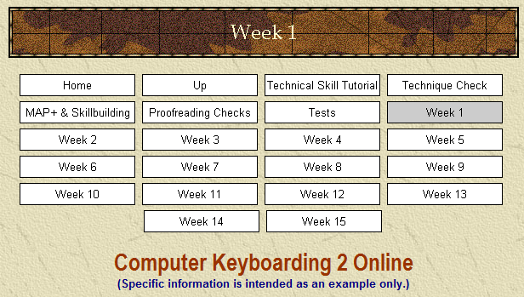

Assignments
Read your Assignment Sheets (see Week 1) each week so you will know what to do and when to do it.
The information on these pages is the online equivalent of face-to-face instruction in a traditional classroom.
13

Slide 14
Due Dates
On-time assignments are critical to your success in an online course. Therefore, late work is penalized to encourage you to keep up with your work.
A grace period of three weeks is allowed at the start of the semester.
All work assigned for a particular week, including practice tests and regular tests, is due no later than Saturday evening each week.
See the Course Outline for details on penalties for late work.
14

Slide 15


Daily Routine
Log on to GDP. (See Getting Started and Week 1.)
If you see an alert bubble by My GDP, click
My GDP, Resources, to open and review
any new student resources such as a
handout, announcement, or Internet link.
Type your lessons following the information on the weekly Assignment Sheets.
  All skillbuilding is uploaded automatically.
  Document processing is uploaded manually.
Review your Portfolio and check for any annotations.
Record your grades in your Progress Folder.
15

Slide 16
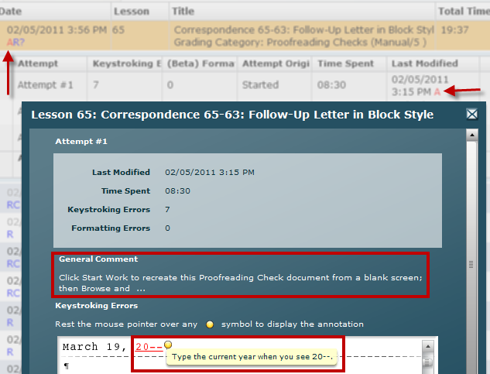
Instructor Annotations
In GDP, click My GDP, Portfolio.
Note that a red “A”
flags all items with
my annotations;
always click
Show All to be sure
that all work is
displayed.
Click the desired
item in the Portfolio
to expand it; then
click Details to view
General Comments
and Annotations.
16

Slide 17
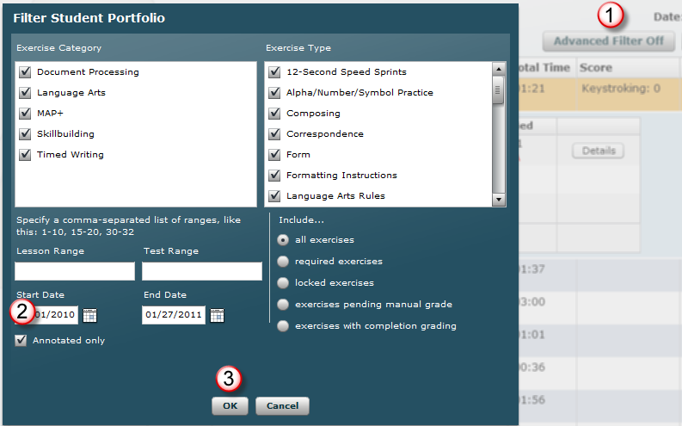
View Annotated Work Only
In the Portfolio, click Advanced Filter Off; in the Filter Student Portfolio dialog box, check Annotated only; click OK.
17

Slide 18
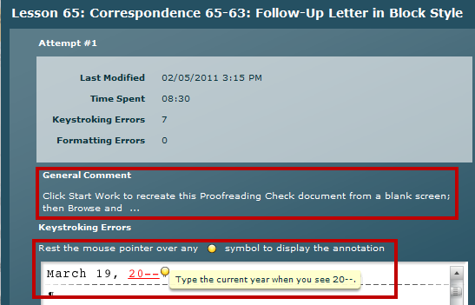
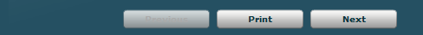
General Comments and Annotations
Read the General Comment; mouse over it to display long comments.
Always scroll down to view any hidden annotated items.
When applicable, click Next to move to the next screen, Previous to move to a previous screen, and Print to print the document and annotations.
18

Slide 19

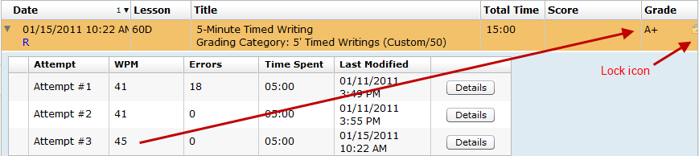
Other Abbreviations (only if a gradebook is in use)
R designates required work.
? In the Grade column means a grade is pending.
C means that item earns a grade of A when it is completed.
A lock to the right of a grade means any subsequent work you may submit for that item will not be considered for grading purposes.
A green check marks the best attempt used for grading purposes.
19
* This example is for a Keyboarding 1 course, not a Keyboarding 2 course.

Slide 20
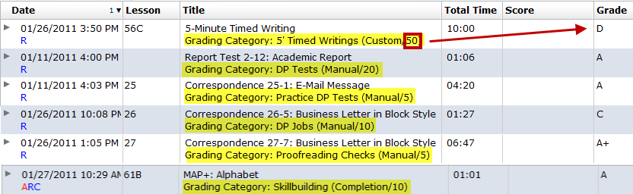
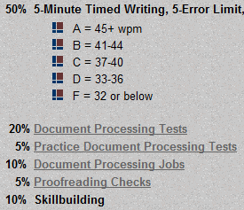
Grading Categories
Grading Category names correspond to each grading category in the course outline for Keyboarding 1.
Being aware of a Grading Category and its grading weight helps you understand where best to concentrate your efforts. In this example for Keyboarding 1, the student should focus on raising the D grade for the Timed Writing category, which is weighted at 50% of the final grade. See the Course Outline for details on each Grading Category for Keyboarding 2.
20
* This example is for a Keyboarding 1 course, not a Keyboarding 2 course.

Slide 21
Typing Technique
Correct position at the keyboard enables you to type with greater speed and accuracy and with less fatigue.
When typing for a long period, rest your eyes occasionally by looking away from the screen.
Change position, walk around, or stretch when your muscles feel tired.
Making such movements and adjustments may help prevent your body from becoming too tired. In addition, long-term bodily damage, such as carpal tunnel syndrome, can be prevented.
21

Slide 22
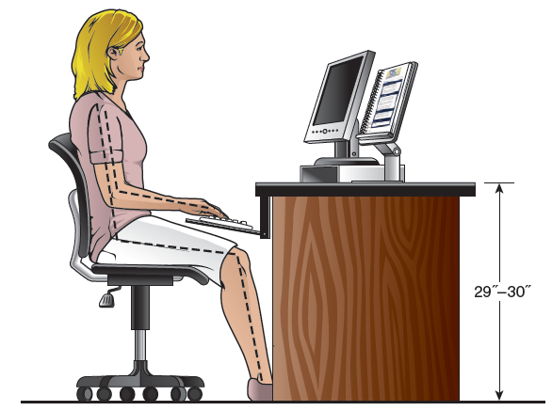
Correct Position
Type by touch with fingertips, not fingernails.
When you can “feel” the raised bars on the “F” and “J” keys, you know you’re on home row.
See page xxix in your textbook for tension-reducing exercises.
22

Slide 23
Workstation
If possible, adjust your workstation as follows:
Position your chair so that your upper and lower legs form a greater-than-90-degree angle and your lower back is supported, with your knees slightly lower than your hips.
Position your text on either side of the monitor as close to the monitor vertically and horizontally as possible.
Position the mouse on a pad next to and at the same height as your keyboard.
Tilt the top of the monitor slightly away from you and slightly farther than an arm’s length from you.
23

Slide 24
Position at the Keyboard
Center your body in front of the keyboard.
Sit slightly reclined, with your lower back touching the back of the chair and your feet flat on the floor.
Keep your elbows close to your body in a relaxed position.
Curve your fingers naturally over the home-row position, with the back of your hands at the same angle as the keyboard.
Move the mouse with your whole arm—not just your wrist.
24

Slide 25
Keystroking
Operate all keys by touch, using the correct fingers.
Keep your eyes on the copy most of the time while typing.
Keep your forearms at a slight downward slant and raise your hands slightly when typing so that your wrists do not touch the keyboard.
Make quick, light strokes, returning your fingers immediately to the home-row position or moving to the next position after each stroke.
25

Slide 26
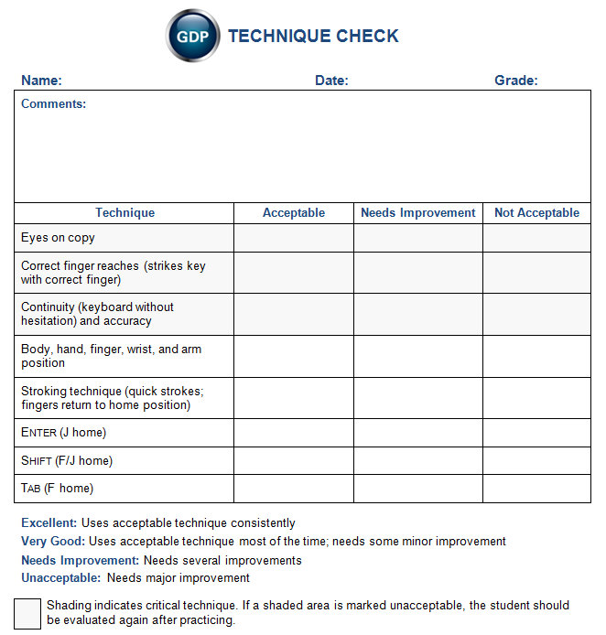
Technique Check
In Week 3, you will be responsible for passing a Technique Check.
See “Orientation to Technique Checks & MAP+” for details.
26

Slide 27
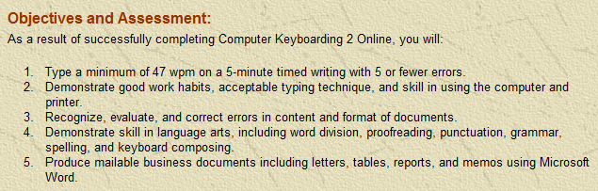
Assessment
See the Course Outline for details on assessment.
27

Slide 28
Assessment Weights and Categories
40% | 5-Minute Timed Writing, 5-Error Limit (by touch)
 | A = 55+ wpm B = 51-54 C = 47-50 D = 43-46 F = 42 or below
30% | Document Processing Tests
5% | Practice Document Processing Tests
10% | Document Processing Jobs: All jobs must be mailable (error free) to earn a grade of A. For jobs that include errors (keystroking or formatting), the severity of the error will be considered when assigning a grade.
5% | Proofreading Checks
10% | Skillbuilding
Up to +10% | Extra Credit: Extra Proofreading Checks, documents, and skillbuilding
Up to -10% | Attendance Deductions
28

Slide 29

Assessment—Timed Writings
You will be given a series of 5-minute timings on campus at the end of the course. The best two timings are averaged to determine your speed.
If your timings are not within the 5-error limit, 2 wpm (words per minute) will be subtracted from the gwpm (gross words per minute) for each error over the maximum number of errors allowed. For example, if your speed was 50 and your errors were 6, your nwpm (net words per minute) would be 48.
29

Slide 30
Assessment—Document Processing
Review Orientation to Word Processing, Keyboarding 2 for these topics:
Practice exercises and document processing
GDP on a Mac
Word Options
File management
Microsoft Word Manual
Lesson 21E: file management and orientation to Practice exercises
Return to GDP routine
Lesson 67J and Correspondence 65-63: typical Practice exercise and DP job
Reference Manual
GDP routines: Start Work, manage and save files, Browse, and Submit Work
Annotations
Edit work and scoring results
Proofreading skills and Proofreading Checks
Extra credit for proofreading
Document assessment, grades, Gradebook, and filters
30

Slide 31

On-Campus Orientation
A mandatory orientation will be held the first week of the semester. Check the Schedule of Classes for details.
All topics in this orientation will be covered.
Bring your supplies, including your Online Software Registration Card.
Be prepared for
hands-on activities.
31

Slide 32


Feedback?
If you have any questions regarding this orientation or GDP, please send an e-mail to:
Happy keyboarding!
Note: This presentation was created to serve as a possible example of an orientation to an online keyboarding course. Your specific course requirements may vary.
32

